Slide 1

WHO Collaborating Centre on
Investment for Health and Well-being Re-designation
Public Health Wales
Looking Back, Looking Forward
Virtual event, 26 March 2026

Slide 2

Overview
A unique role as the first and only WHOCC in the world dedicated to
promoting and increasing investment in healthy prosperous lives for all
Designated in 2018, re-designated until 2030: UNK-294
Network of more than 800 WHOCCs globally across 80+ countries
Supporting WHO, Wales and Public Health Wales – informing and implementing global, European and national goals and priorities
Providing expertise and know-how, novel tools and solutions, forward action-oriented thinking, capacity building and income generation…
Diverse and agile portfolio convening and working with partners across sectors and disciplines in Wales, the UK and internationally
Senior team: Sumina Azam, Mariana Dyakova, Ashley Gould, Jo Peden, Joanne Hopkins, Liz Green, Rebecca Hill, Rebecca Masters, Tracy Black
Notes:
Mobilise expertise, know-how and resources, develop novel tools and solutions, advance forward thinking and convene partners across sectors and disciplines to support:
WHO resolutions, strategies, initiatives and networks
Wales’ legislation, policies, strategies and priorities
Public Health Wales Long Term Strategy and International Health Strategy
Diverse and agile portfolio including health equity, well-being economics and investing in prevention, health in all policies and health impact assessment, sustainability and climate change, behavioural science, health along the life course, trauma-informed approaches and violence prevention…

Slide 3
Time | Agenda and Speakers
15:30 | Welcome and Introduction Chair: Dr Sumina Azam, National Director for Policy and International Health, WHOCC Director
15:35 | Cabinet Secretary for Health and Social Care, Jeremy Miles MS Recorded message
15:40 | Welsh Government Address Professor Isabel Oliver, Chief Medical Officer for Wales Lisa Wise, MBE, Deputy Director, Health, Social Care and Early Years
15:50 | Public Health Wales Address Pippa Britton OBE PLY, Non-Executive Director and Chair of the Board Dr Tracey Cooper, Chief Executive
16:00 | WHO Address Chris Brown, Head of the WHO European Office for Investment for Health and Development, Venice, Italy and WHOCC Responsible Officer
16:10 | WHOCC Key Achievements and Forward Look Dr Mariana Dyakova, WHOCC Deputy (Technical) Director
16:20 | Reflections and Q&A Chair: Dr Sumina Azam
16:30 | Close

Slide 4
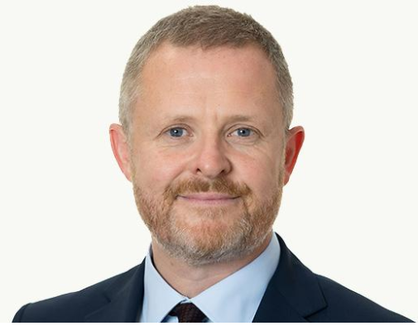
Cabinet Secretary for Health and Social Care, Jeremy Miles MS
Welsh Government
Recorded video message
https://www.dropbox.com/scl/fi/pv7d8jtq65rral4u2h8hd/WHO-event.mp4?rlkey=pkc7qp8z3yswkkywnh3of21ff&st=7kc5l7gp&dl=0

Slide 5
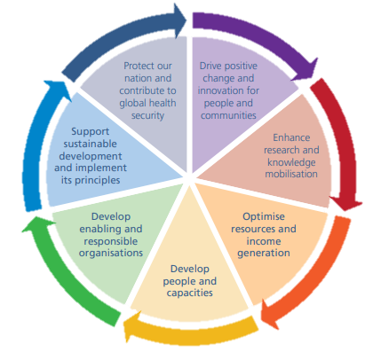
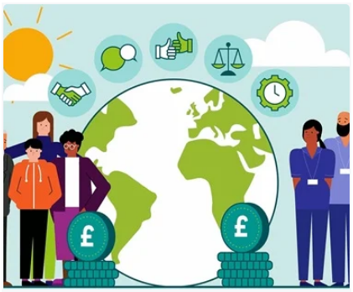
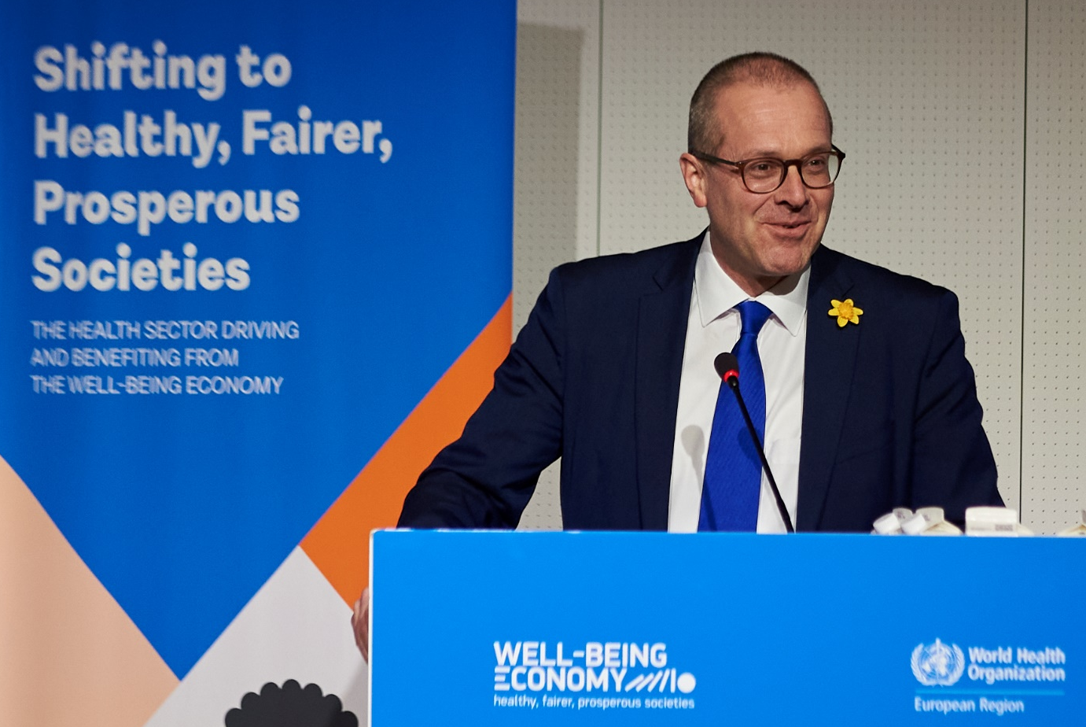
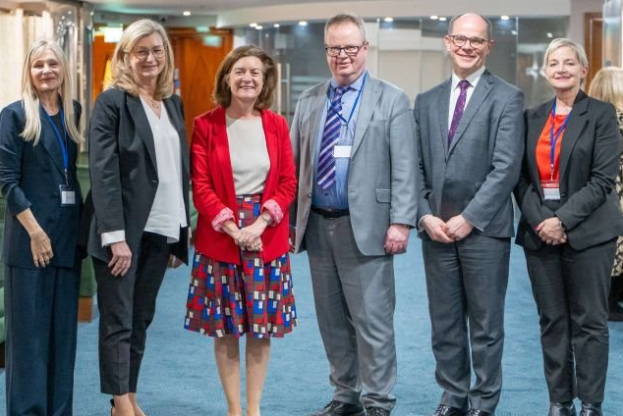
Key achievements 2018 – 2026
Wales – a global champion and a live innovation site for
Well-Being Economy, Health Equity and Prosperity for All
Memorandum of Understanding between the Welsh Government and the WHO Regional Office for Europe
Welsh Health Equity Status Report initiative and Solutions Platform
Well-being economics and value - investing in prevention, Value-Based Public Health, Well-being and Foundational economies
Adversity and trauma across the life course and services – ACEs, violence prevention and inclusive resilient communities
Sustainable Development and Health in All Policies – Health Impact Assessment, Sustainability and Health, Climate Change
Behavioural Science informed policy and practice
International Horizon Scanning & learning, partnerships & networks
Notes:
Established and strengthening the organisational and Wales’ role as a global influencer and live innovation site for health equity and prosperity for all
Enabled and delivering to an MOU between the Welsh Government and the WHO Regional Office for Europe enhancing Wales’ visibility and impact on the global stage
Advanced professional development, expertise building and funding generation – for Wales & WHO

Slide 6
Sustainable Well-being Economies with Health and Equity at the Heart
Thinking globally - Acting locally
Global movement European strategies & alliances
Regional synergies, challenges and assets
National enabling context and levers
Local needs and organisational drive
Sustainable Development
Well-being Economy
Well-being of FG
Social, Planetary, Economic
and Human capitals
Levels
of working
Value
and
Impact
Foundational
Economy: 3+1Ps
Anchor role
Investing in prevention
Reducing inequities
Improving health outcomes

Slide 7


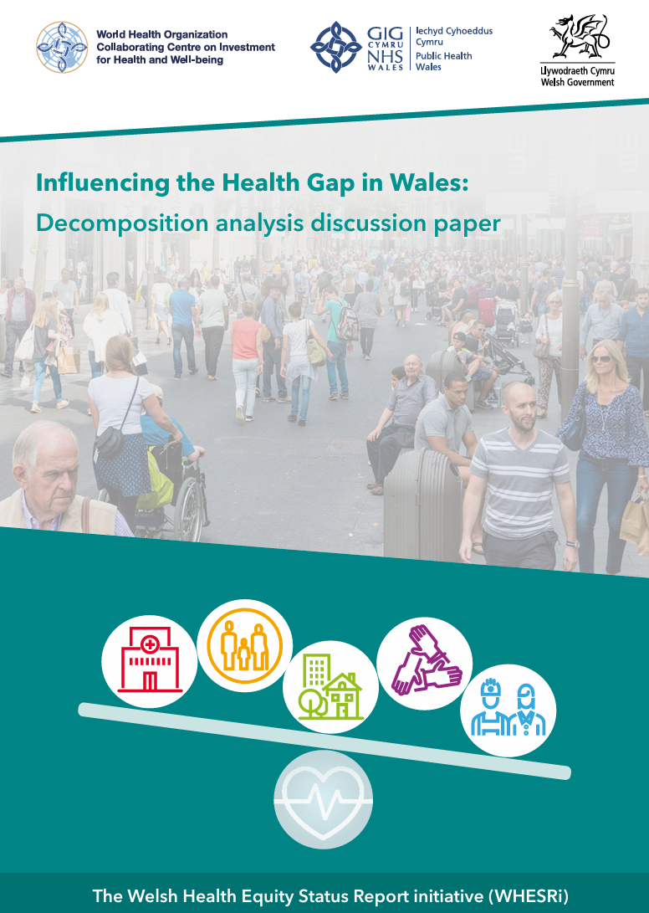
Welsh Health Equity Status Report Initiative (WHESRi)
Unique programme driving system change, engaging with key stakeholders and
developing solutions towards closing the health gap
First of its kind Health Equity Solutions Platform recognised and used in Wales and globally - evidence, data, policies and tools
Implemented and supporting landmark WHO European initiatives – HESRi 1&2 and SIVAWG
Strengthened national focus and capacity for addressing inequities - clear, accessible evidence on the scale, drivers, costs and solutions
Advanced understanding of the root causes and inter-sectionality - innovative analytical methods (e.g. decomposition analysis)
Improved cross‑government and cross-sector coordination - breaking silos, convening partnres, providing system leadership
Elevated Gender Equity within health equity – mobilising evidence and driving action in Wales and internationally
WHESP in numbers
27,000 views
6600 active users (2024/25)
8 new resources in 2025
7 Spotlight feature
3 MailChimp campaigns x 605 stakeholders each (2024/25)
Notes:
Established a unique Welsh Health Equity Status Report initiative (WHESRi) & SP applying an innovative
WHO framework and methodology to help reduce the health gap in Wales – serves as a unique one-stop shop for HE solutions

Slide 8
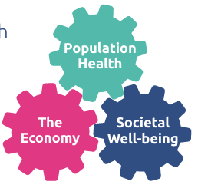

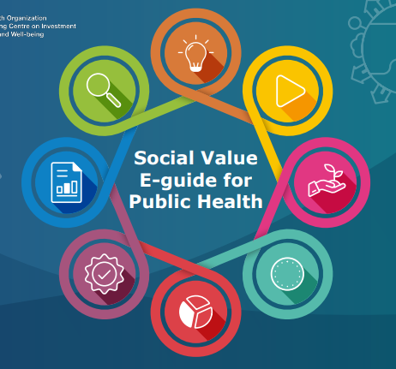

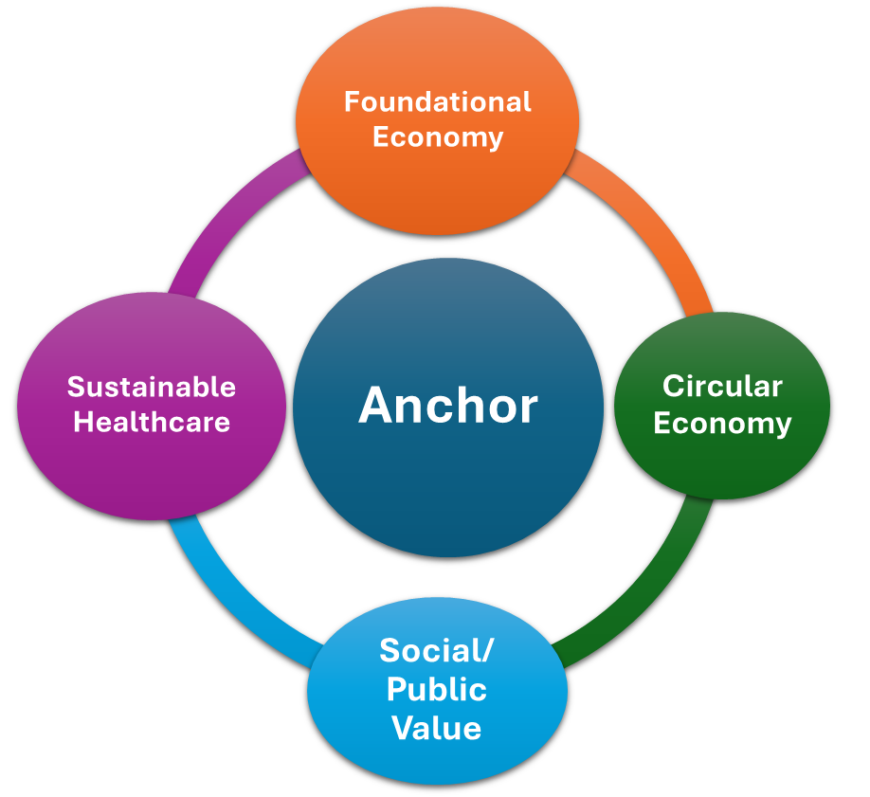
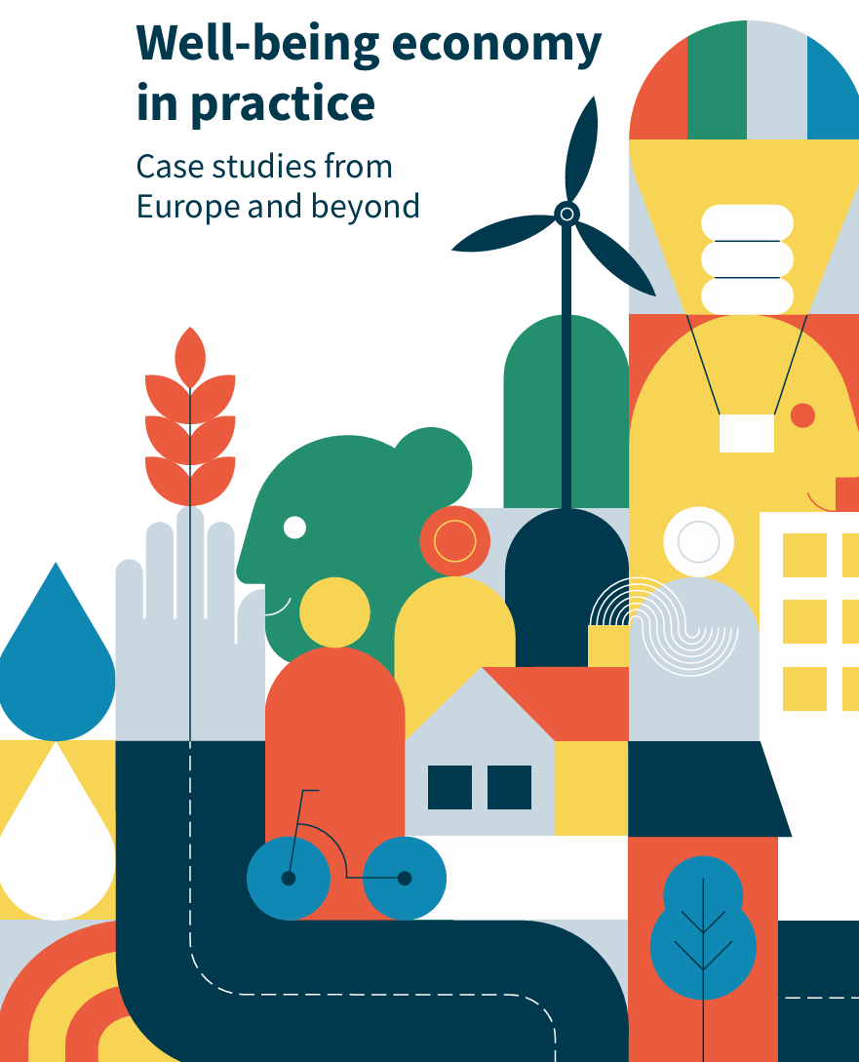
Well-being Economics and Investing in Prevention
Leading the way in economic and social value thinking and practice
towards prioritising prevention and adopting Well-being Economies
Positioned investing in prevention as central health and economic priority – wider well-being, societal, financial and ecological returns
Established and advancing Value-Based Public Health – Social Value evidence and tools (unique Database & Simulator), capacity building
Well-being Economics expertise, analyses and modelling, income generation and novel investment instruments
Helped convene leader nations and key stakeholders across health, economy and finance sharing best practice and driving innovation
Realising the potential of the Health Sector (NHS) as an Anchor and a Foundational Economy – in Europe, nationally and locally
Support implementing the WHO European WBE Initiative and the WHO Resolution on the Economics of Health for All (EHfA)
Notes:
Established and advancing a Well-being Economics and Value portfolio, strengthening the case for investing in prevention and helping to build Well-being Economies in Wales and beyond

Slide 9
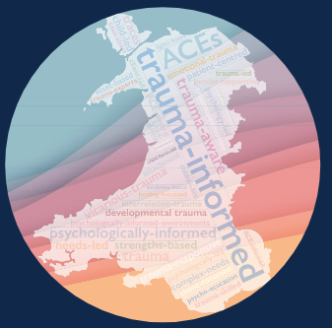


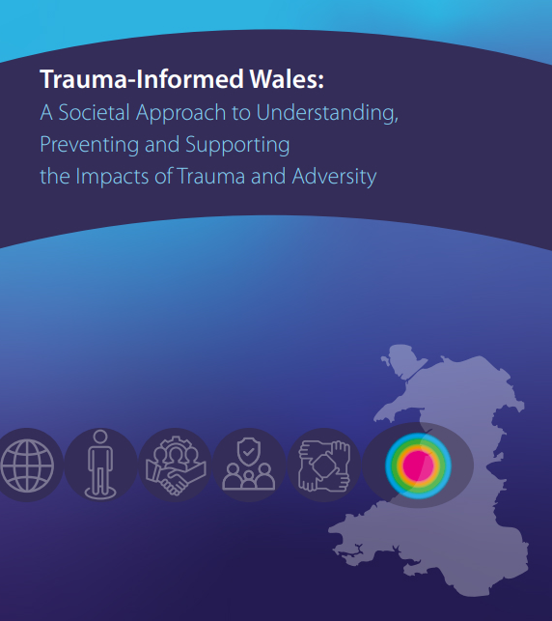

Addressing Adversity and Trauma across the Life Course
Established Wales as a global reference point for violence and
ACEs prevention and trauma-informed cross-sector approaches
Shaped strategies and built capacities in Wales and internationally (WHO INSPIRE)
Violence Prevention Portal - multi‑agency data sharing, monitoring, strategic and operational response
Mobilised a social movement towards a trauma-informed approach
Shifted public awareness and behaviours (to act) - #SafeToSay and #TimeToBeKind
Built a whole system approach - ‘ACE aware Wales’ and ‘Wales Without Violence’
Adversity in later life, loneliness and isolation – importance of social connection
Organisational and cultural transformation to prevent harm – equipped workforce across sectors (schools, criminal justice, health and social care)
Advocacy for amplifying marginalised voices and building inclusive communities - racial trauma, forced migration, mental health, violence against women, and amongst children and young people
Notes:
Progressed a portfolio of work to mitigate & address adversity and trauma across the life course with a focus on preventing ACEs, violence and building inclusive and resilient communies

Slide 10
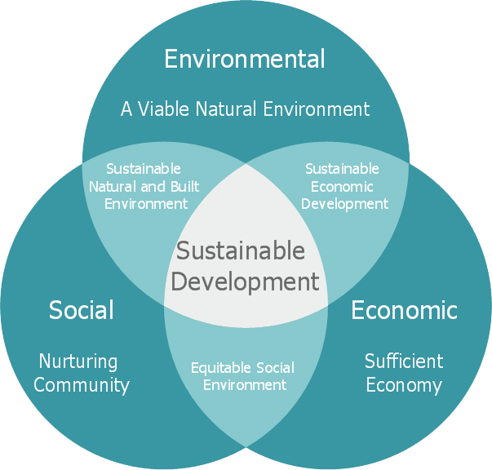



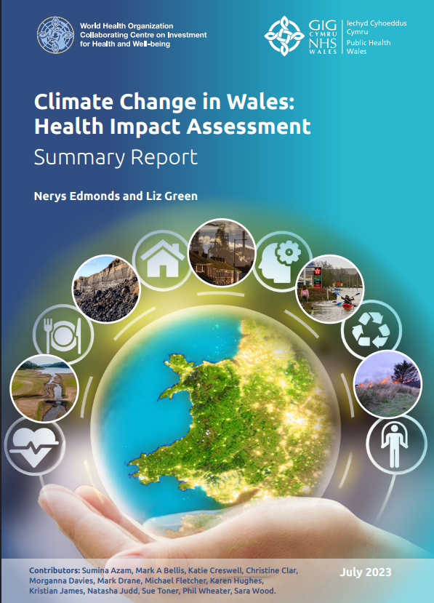
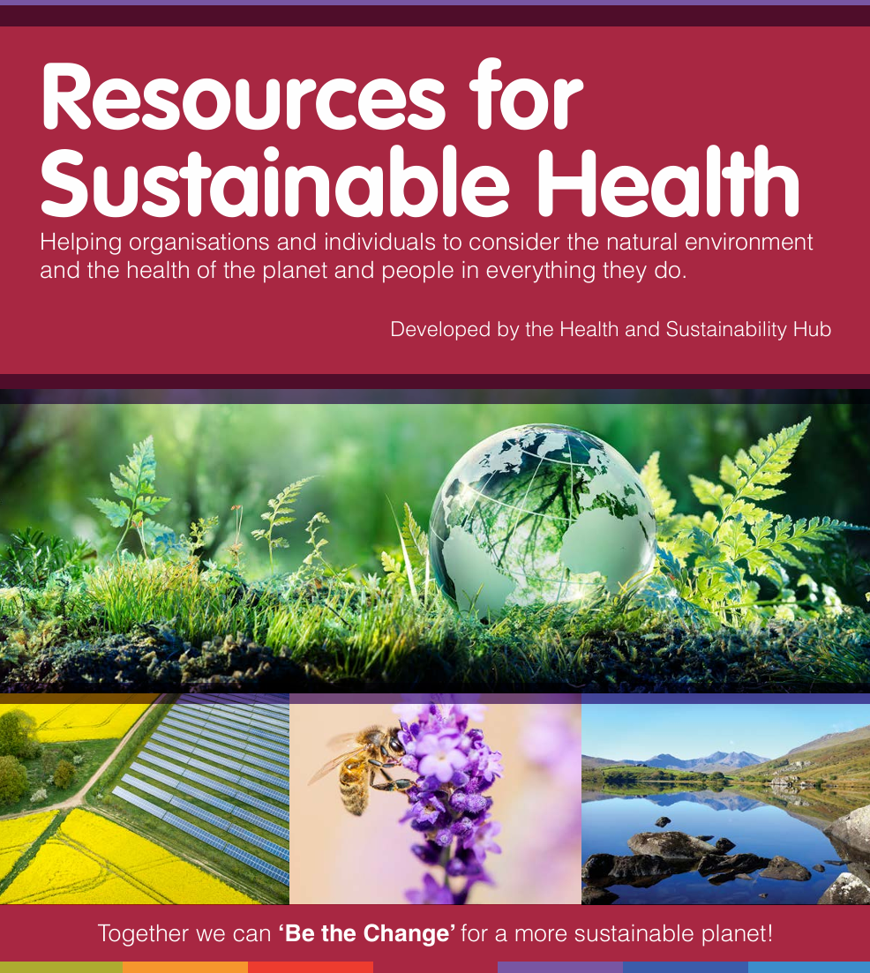
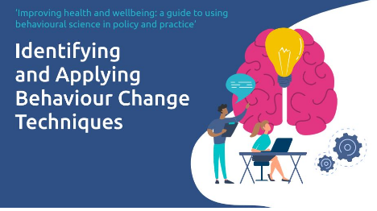
Sustainable Development and Health in All Policies (HiAP)
Leading the way in HiAP practice, generating evidence, tools and resources
for embedding HIA, Behavioural Science and Sustainability approaches
Embedded health considerations into climate, housing, trade, planning, and sustainability policies
Robust assessments of wide‑ranging determinants - climate change, COVID‑19, international trade, fuel poverty, winter pressures, etc.
Built national and international influence and credibility for HIA - major legislative and policy decisions supported by expertise, collaboration and capacity building
Advanced organisational sustainability and environmental action - decarbonisation, biodiversity and procurement aligned with public health
Advanced action for climate change - WHO ATTACH programme
Behavioural Science for Better Health strategic plan aligned with WHO Resolution - grown capacity, enabled support, helped optimise investment in preventative services
Established Behaviour Change Agents programme, Behaviourally Informed Communications Initiative and a thriving Community of Interest
Notes:
Established and progressing a portfolio of work on Sustainable Development and Health in All Policies, and applying Behavioural Science to inform policy and practice

Slide 11
WHO CC Work Plan 2026 – 2030
Terms of Reference (TOR) Activities
TOR 1: Provide evidence and expertise to WHO supporting technical assistance to Member States to develop capacity and implement effective inter-sectoral policies and strategies for health and equity across the life course and in living, working and learning settings.
TOR 2: Produce and build capacity for using investment tools, well-being economics methods, and cross-disciplinary approaches, assessments and insights to support WHO and Member States to adopt and progress well-being economies for healthy people and societies.
TOR 3: Provide support to WHO to implement multi-sectoral workshops and policy dialogues on well-being economy approaches and solutions for promoting and improving well-being and health equity.
Accelerate action to place health and gender equity at the center of policies and investments across Member States and support WHO to prevent violence against women and girls
Accelerate well-being economy approaches across Member States, Regions and Cities, strengthening the case for investing in healthy prosperous lives for all
Maximising the impact of policies and investments to deliver health and well-being across the life course, sectors and settings for living and ageing well

Slide 12
Thank you!
World Health Organization Collaborating Centre On Investment for Health and Well-being (phwwhocc.co.uk)
Public Health Wales, 2 Capital Quarter, Tyndall Street
Cardiff, CF10 4BZ

