Slide 1
Sample Workshop Presentation Deposit Plan

Slide 2
Outline of session

Slide 3
Outline of Plan / Stage
Context
Overview
Duration
Q and A

Slide 4
Definition of HIA
‘Health Impact Assessment is a combination of procedures, methods and tools by which a policy, programme or project may be judged as to its potential effects on the health of a population, and the distribution of those effects within the population’
Gothenburg Consensus (1999)
HIA uses a broad social model of health incorporating also wellbeing through the lens of wider determinants of health.
Notes:
HIA is defined as a combination of procedures, methods and tools by which a policy, program or project may be judged as to its potential effects on the health of a population, and the distribution of those effects within the population.
A major objective or purpose of an HIA is to inform and influence decision-making; however, it is not a decision-making tool per se. HIA is a process that considers to what extent the health and well-being of a population may be potentially affected by a proposed action - be it a policy, program, plan, or project. It provides a systematic, objective, yet flexible and practical way of assessing potential positive and negative health impacts associated with a particular activity. It also provides an opportunity to suggest ways in which health risks can be minimized and health benefits maximized.

Slide 5
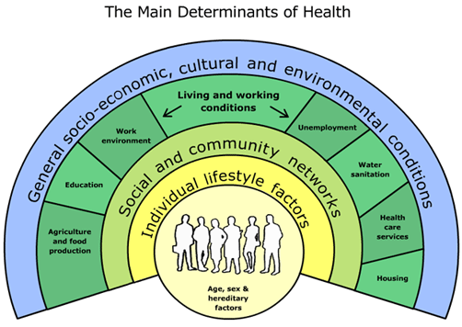
Health and Wellbeing outcomes are shaped by wider social and economic processes
Source: Based on Dahlgren and Whitehead (1991)

Slide 6
Identifying the health impacts
Identification of possible, potential impacts should be described according to:
Whether they are positive/negative
Population groups affected
How impact may occur – positive / negative
Scale of impact – major / moderate / minimal
When impact may occur – short to long term
Any evidence to support the above...
identify solutions/recommendations

Slide 7
Key data (LA health & community data that is relevant to issues addressed within the LDP and can aid discussion within the HIA workshop)

Slide 8
Population projections

Slide 9
Population profiles eg.
by deprivation
Households by income
LSOA’s by deprivation
Child poverty rates

Slide 10
Employment
Skills for employment

Slide 11
Economic assets
Rural economy

Slide 12
Affordable housing:
Housing profile
by tenancy
Affordability
Social
LDP projections

Slide 13
Lifestyle data
Notes:
Preferred strategy IIA finding suggestions- encourage the use more sustainable form of transport and development locations, reducing the need to travel by car

Slide 14
Health profile

Slide 15
Wider determinants could include:
Social isolation
Air quality
Rurality
Transport
Active travel

Slide 16
Discussion / break out groups

