Slide 1
Update on public health engagement and spatial planning
Dr. Gill Richardson – Assistant Director, Policy and International Health, WHO CC on Investment for Health and Wellbeing, Public Health Wales

Slide 2
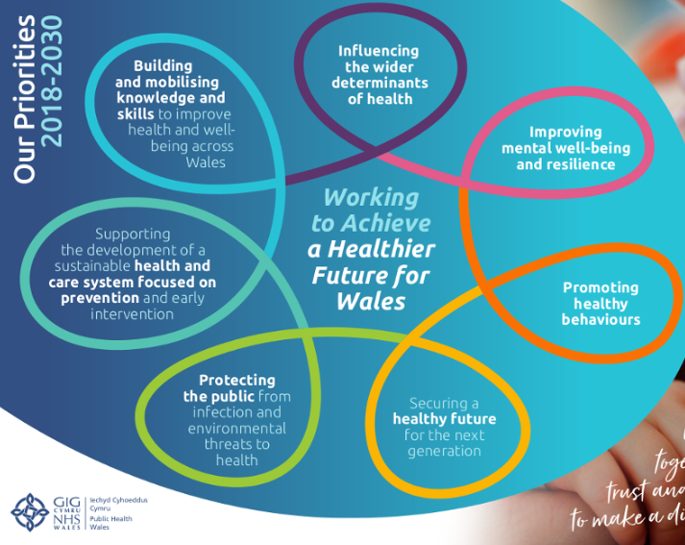
PHW Commitment
Strategic Plan 2019-22
By 2022 - We will have built on current relationships, working collaboratively with partners and policy makers to inform and support sustainable policy development and cross-sectoral working.
Developing an integrated approach to the way in which we respond to land use planning consultations and applications in Wales.
Placemaking, Health & Wellbeing 2020

Slide 3
Recent Activity
Environmental Public Health Service and Wales Health Impact Assessment Support Unit
Planning apps (Major/significant planning developments)
2018/19 = 23
WG national policy consultations (planning & wider environmental aspects)
2018/2019 = 10
Health Impact Assessments
2018/2019 = 3 (LDPs) / 1 QA of HIA Report / various workshops
‘HIA for LDPs: A Toolkit for Practice’ being finalised

Slide 4
Ways of working
Examples of Collaboration
Updated LDP (HIA) – Public Service Board, LPHTs and Planning Policy Team in Bridgend, Denbighshire, Flintshire and Wrexham
Closer ‘regional’ collaboration – Planning officers, Health Board, Local Public Health Team and PHW
Increased presence at stakeholder workshops, seminars and working groups – moving upsteam
Public Health England – connections with PHE Healthy Places Team

Slide 5
Future
2020 – proposed new way of working within PHW - single point of contact for coordinating a sole integrated organisational response to spatial planning in Wales
Aims are to
Influencing the wider determinants wider determinants of health
Protecting the public from environmental threats to health
Building and mobilising knowledge and skills to improve health and well-being across Wales

Slide 6
Health and Well-being Determinants
PHW will provide holistic response / engagement focussed on key priorities in aiming to achieving a healthier future for Wales
Influencing the wider determinants of health
Improving mental well-being and resilience
Promoting healthy behaviours
Securing a healthy future for the next generation
Protecting the public from infection and environmental threat to health
Supporting the development of a sustainable health and care system focused on prevention and early intervention
Building and mobilising knowledge and skills to improve health and well-being across Wales

Slide 7
Health Priorities
Clean Air
Tackling climate change
Obesity and Physical Activity
Reducing health inequalities
Natural and Built environment

