Slide 1
Workshop 1: Opportunities for collaborative strategic approaches in planning development
Map out “who does what” in the delivery of the LDPlan – in particular public health and planning roles
Notes:
Current practice and explore areas of synergy for collaboration.

Slide 2
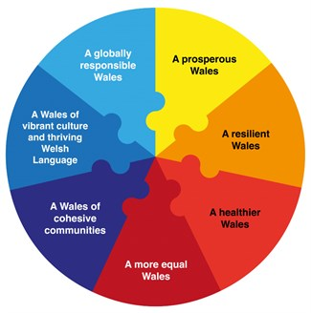
Consider…
“All development plans must ensure they contribute to achieving the economic, social, environmental and cultural well being goals of Wales”
For the integrated assessment process, map out who does what
What are the core goals with planners & health?
Identify when public health are to be engaged
Identify any gaps in engagement – improvements?
Feedback observations!
Placemaking, Health & Wellbeing 2020
Notes:
To achieve the aim of PPW and to contribute to a Healthier Wales (contribute to reducing health inequalities)
What works well at present
What doesn’t
Areas for improvements

Slide 3
What is a sustainable
place?
When & where is health evidence sought?
Is this information currently collated?
Placemaking, Health & Wellbeing 2020
Notes:
How do we get to sustainable place?
Have we achieved this? What’s holding us back?
What does it look like?
Do we monitor and celebrate success

Slide 4
Stages of the
LPD process
Points of opportunity?
Placemaking, Health & Planning 2020
Notes:
Have handouts on each table showing the stages of the LDP process – recognised points of opportunity – are we maximising these?
What happens at present
What could be done going forward

Slide 5
Feedback
3 key points from group discussion
All groupwork observations will be collated and written up
Help inform areas for improved collaboration
Notes:
Facilitator on each table
Write down key points discussed – all about collarboration!
Wish list
Obstacles
Simple ‘quick fixes’

