Slide 1

Workshop 2: Maximising the value of health evidence at development management stage
Using the described scenario – what should a good consultee response look like?
Notes:
Have a scenario on tables to work through – the aim of the exercise is exploring opportunities for collaboration and how to ‘add value’
Series of questions to help guide you
Don’t get too bogged down in specifics – more the key aspects that we are concerned about!

Slide 2
Consider…
“What should a good response look like…?”
Who are the consultees for ‘health and wellbeing’?
What evidence are ‘musts’?
What evidence are ‘likes’?
Placed based information v local health and wellbeing needs
‘response’ purely a paper exercise?
Collaboration maximised? Is engagement continuous (i.e. outcomes / monitoring / further dialogue etc.)
Placemaking, Health & Wellbeing 2020
Notes:
Question of timing!
Pre application consultation
Post application involvement!
WHAT CAN WE COLLECTIVELY DO BETTER

Slide 3
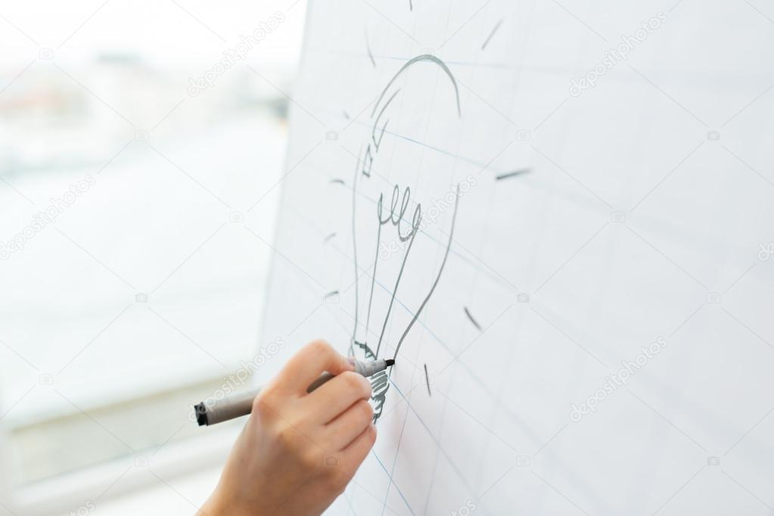
Feedback
3 key points from group discussion
All groupwork observations will be collated and written up
Help inform areas for improved collaboration and ways of working

