Slide 1
Developing a Supplementary Planning Guidance Template for ‘Healthy Environments’
Liz Green, Programme Director for HIA
Lucy O’Loughlin, Consultant in Public Health

Slide 2
10,000

Slide 3
Strategic Priority 3 – Deep Dive

Slide 6
Obesity- A Complex Public Health Issue
Strategic Priority 3 – Deep Dive

Slide 7
Learning from the International Evidence¹
Obesity is a complex adaptive system- requires a dynamic, flexible, adaptable approach
Full partnership engagement - with clarity around contributions
Long term commitment
Strong and visible systems leadership
Commitment to monitoring and evaluation.
  System wide action requires the ability to measure change both quickly and robustly.
Create environment and conditions to enable change
France: EPODE , Netherlands: JOGG and Amsterdam Healthy Weight Programme – Gemeente Amsterdam, USA: Healthy Communities Study, UK: Whole systems approach to obesity

Slide 8


Slide 9
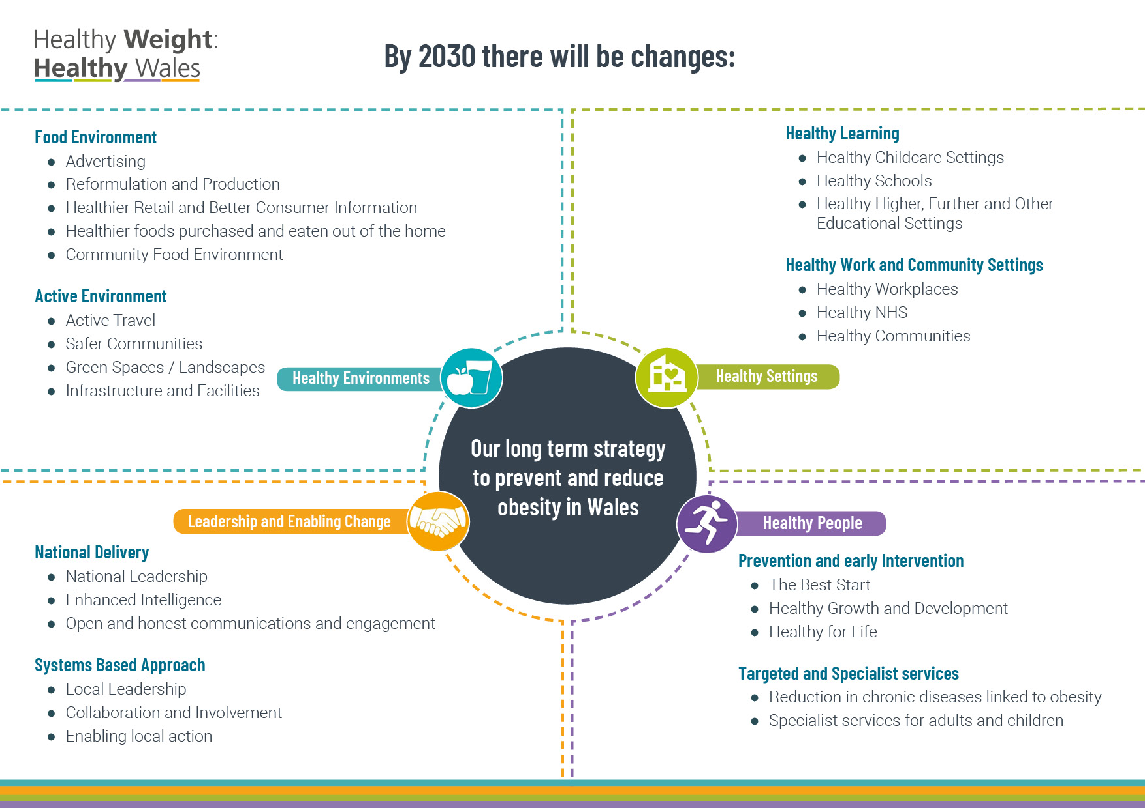

Slide 10
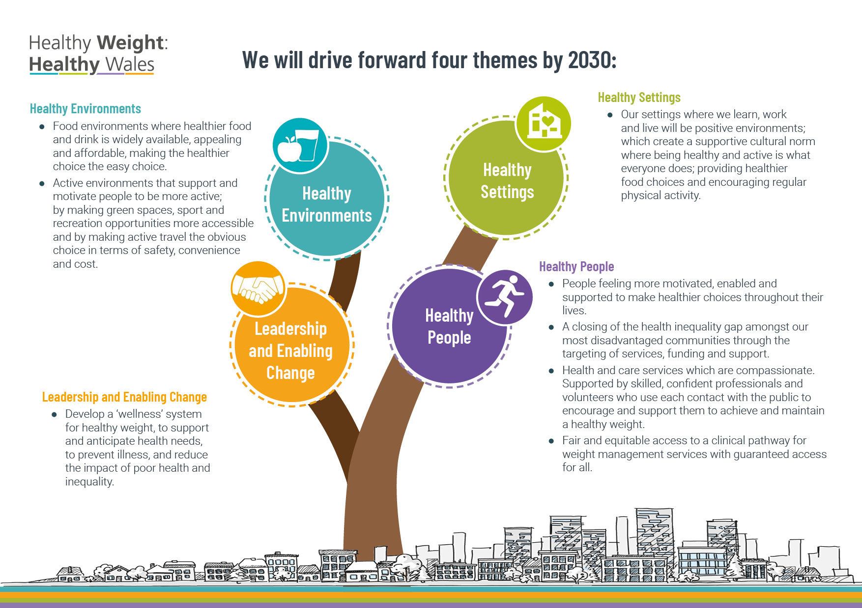

Slide 11
Healthy Weight Healthy Wales
Areas most Relevant to Planning
Planning - assist the delivery of better population health and wellbeing through the land use planning system.
Active travel- integrated walking and cycling route networks, 20mph speed limits, public transport connections, behaviour change techniques
Green Spaces –highlight importance, use and access to unlock potential
Sport, recreation and play- facilities, community hubs, safer streets
Community Food Environment- limits on establishment of HFTs around schools and communities and support to increase healthier food options on high streets
Advertising - A ban on advertising and promotion of HFSS foods trains, buses, schools public spaces

Slide 12
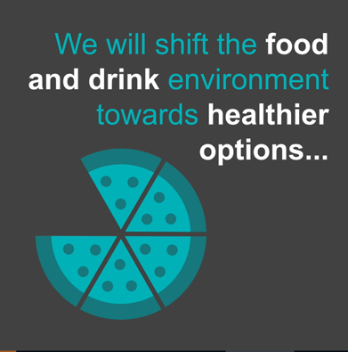
Healthy Weight Healthy Wales
Delivery Plan- 2020-2022
Develop support for local planning decisions.
We will develop Supplementary Planning Guidance (SPG) template and supporting guidance for ‘Healthy Weight Environments’ in Wales to assist local planning officers

Slide 13
Template for a Supplementary Planning Guidance for ‘Healthy Environments’
Aim of the document
To support spatial planners and public health teams in practice
Provide a resource which can aide addressing obeso-genic environments
To be a flexible and adaptable tool for Local Authorities to use in tandem with a range of other local interventions and policies
To support and strengthen a consideration of health and well-being in spatial planning and development

Slide 14
The importance of spatial planning in relation to health and wellbeing and health to spatial planning
Housing
Natural and built environment
Physical Activity
Behaviours affecting health – fast food outlets, gambling outlets
Health care facilities and service provision for the population
Welsh Government’s National Development Framework states
‘physical and mental health and well-being outcomes are central to spatial decision making’

Slide 15
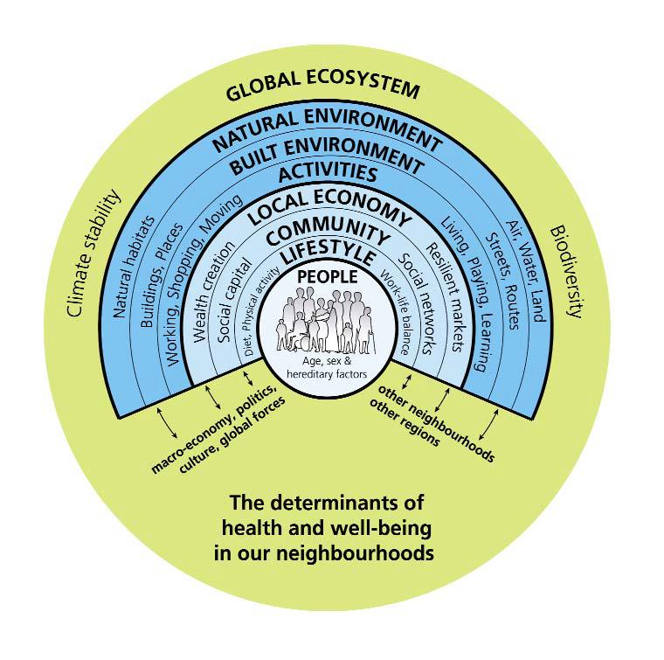
The determinants of health and wellbeing
Spatial planning has the ability to positively / negatively influence health
Barton and Grant, 2006

Slide 16
Progress and process
2 workshops held (2019) - wide range of national / local spatial planning and health practitioners and policy officers
Clear feedback that a template / resource is welcome to support both public health and spatial planners to address the proliferation of Fast Food Outlets (FFOs) and support creating healthy places and environments.
Funding obtained. Research Officer hired
2 stakeholder workshops to be held alongside meetings (Spring 2020). Feedback and comments incorporated into draft.
Publish a Template Supplementary Planning Guidance (SPG) for ‘Healthy Environments’ and supporting guidance

Slide 17
Outcome
Provides an opportunity for dialogue at an early stage between planning officers, public health practitioners and local authorities
Supports the delivery of the ‘Healthy Weight: Healthy Wales’; WBFGA and NDF aims and objectives
Evidence and strategies to develop a healthy environment including a focus on food
Promote healthy built environments that encourage active travel and create green and blue spaces
Long term adoption of a ‘Health in All Policies’ approach to planning and deliver Wellbeing Goals and 5 ways of working
Can be utilised along with other interventions, policies and tools

