Slide 1

Health Impact Assessment
HIA
Bridgend local Development Plan
Notes:
Not going to focus on the details of HIA or LDP – presentation will focus on how we undertook an HIA for a large project.

Slide 2
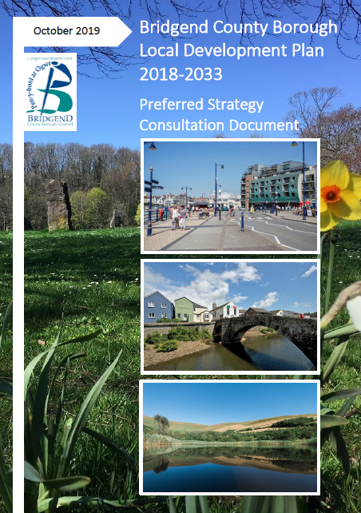
Context
HIA
Replacement Local Development Plan for 2018-2033
Land-use Framework
  Housing
  Employment
  Town Centres
  Public Open Space
  Renewable Energy
  Infrastructure (Inc. health facilities)
Notes:
(interrelated) potential positive, detrimental or unintended consequences for health

Slide 3

Health Impact Assessment
HIA
Why HIA?
The Public Health (Wales) Act 2017
  Requires a HIA to be carried out by public bodies to assess the likely effect, both short and long term on physical and mental health.
  HIA regulations are not yet live -anticipated soon.
Notes:
Not talking about specific details of HIA but more the process.
Requires a Health Impact Assessment (HIA) to be carried out by public bodies to assess the likely effect, both short and long term on physical and mental health.

Slide 4
Health Impact Assessment
HIA
Development Plans & HIA – why?
Assesses the potential positive, detrimental or unintended consequences for health and well-being of the proposed Development Plan as it emerges and how it will impact on the population of Bridgend County Borough.
It will also consider inequalities and assess the potential impacts on vulnerable groups within this population.
The HIA will provide a set of evidence based recommendations and suggestions to be considered within the LDP development process.
Notes:
HIA currently not statutory – but soon will be!

Slide 5
OUR APPROACH TO HIA
HIA
Bridgend Case Study

Slide 6
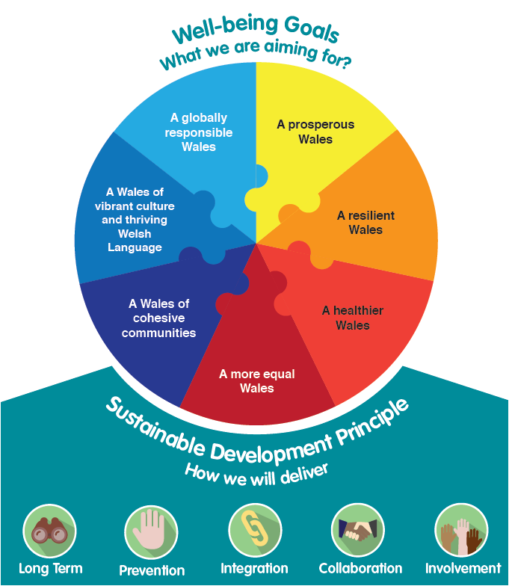
Engagement and a collaborative approach to HIA
HIA
Well-being Act / 5 Ways of Working
Notes:
5 Ways of working

Slide 7
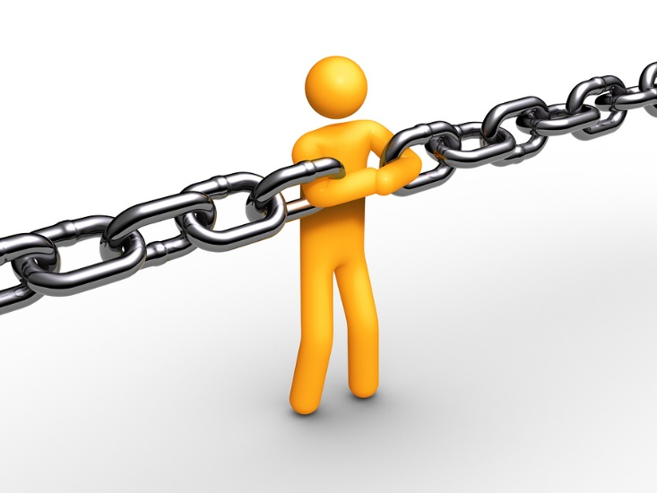
Benefits of engagement and collaboration
HIA
Increases awareness across different organisations of how decisions may affect health
Identifies the connections between health and other policy areas
It helps us problem-solve –health related issues

Slide 8

Benefits of engagement and collaboration
HIA
Co-ordinates action between sectors to improve and protect health
Collaboration brings people (and organisations) closer together
Collaboration helps people learn from each other
It opens up new channels for communication

Slide 9
Benefits of engagement and collaboration
HIA
Promotes evidence-based planning and decision-making
Supports the development of environments and services that meet local needs

Slide 10
Engagement and Collaboration
HIA
HIA
PHW
(WHIASU)
PSB
LDP Team
Notes:
Rationale for involving PHW / PSB
Why did we engage with PHW? – expertise and we did not want this to be a tick box exercise -
As far I am aware this is first time this has happened so you have the opportunity to really sell this as a sustainable way forward….

Slide 11


Engagement and Collaboration
HIA
Why did we engage with WHIASU (Public Health Wales)?
Expertise & knowledge
Did not want this to be a tick box exercise
Notes:
assesses the potential positive, detrimental or unintended consequences for health and well-being of the proposed LDP as it emerges and how it will impact on the population of Bridgend County Borough.

Slide 12

Role of the PSB - Champion
HIA
Why did we engage with the PSB?
Key stakeholders
The Assets Sub Board of the PSB agreed to host the HIA work.
Notes:
Collaboration nothing new in planning – PSB provided the platform to target key stakeholders in one place…..
Health Impact Assessment “screening“ workshop to engage local stakeholders at an early stage in identifying how the draft Preferred Strategy for the LDP might impact on key health and well-being priorities in the County Borough of Bridgend, and what areas of evidence on health and well-being should be included in the LDP to ensure that health and well-being are promoted and protected in the plan.

Slide 13

How did we do it?
HIA
PSB: HIA Screening Workshop
Notes:
Not a talking shop. Key aims and objectives / focused session.

Slide 14
PSB Screening Workshop
HIA
At the start of the process - LDP still in development.
Key aim:
Designed to inform the content of the LDP at an early stage.
To ensure consideration and integration of health, well-being and inequalities throughout the preparation of the LDP.
Establish what areas of evidence on health and well-being should be included in the LDP to ensure that health and well-being are promoted and protected in the plan.

Slide 15
PSB Screening Workshop
HIA
The Workshop
19 people participated in the workshop
key health indicators identified for Bridgend
Discussion - value of planning for economic, environmental and social well-being.
Two discussion groups were facilitated to conduct an initial Health Impact Assessment of the LDP.
  Key population groups who need to be considered in the LDP
  the potential impacts of the LDP on the health and well-being of the people of Bridgend were identified.
Notes:
Refine slide.

Slide 16
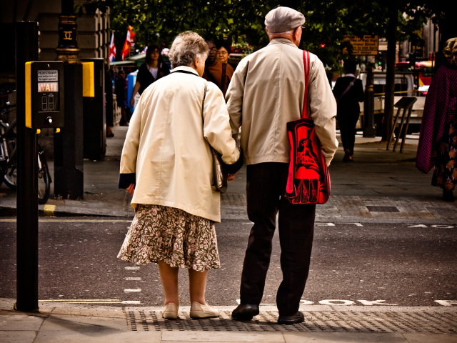
Outcomes of workshop
HIA
Summary of Findings – stand out issues
Population groups potentially impacted by the plan were:
Older adults – the importance of recognising the needs of the ageing population in housing and development design
Notes:
Unemployed people
Homeless people
Areas in need of social and economic regeneration
People on a low income
Disadvantaged groups, including gypsies and travellers and people fleeing domestic abuse

Slide 17


Outcomes of workshop
HIA
Summary of Findings – stand out issues
Bridgend – child obesity levels
Children and young people –recognising the importance of access to green outdoor space, active travel and healthy food environments as drivers in reducing obesity levels in children
Notes:
Bridgend – child obesity levels
Unemployed people
Homeless people
Areas in need of social and economic regeneration
People on a low income
Disadvantaged groups, including gypsies and travellers and people fleeing domestic abuse

Slide 18
Outcomes of workshop
HIA
Determinants of health and well-being potentially impacted by the LDP were:
Affordable and high quality housing
Employment opportunities
Lifestyles – in particular the importance of ensuring that opportunities for physical activity are increased
Community Safety
Cohesive communities
Making best use of existing community assets and town centres
Air quality and noise pollution
Green/blue spaces and biodiversity for health and well-being
Connectivity and easy access to services – including health services
Inequalities in healthy life expectancy
Climate change impacts / renewable energy
Green and active transport
Notes:
Just skim over

Slide 19
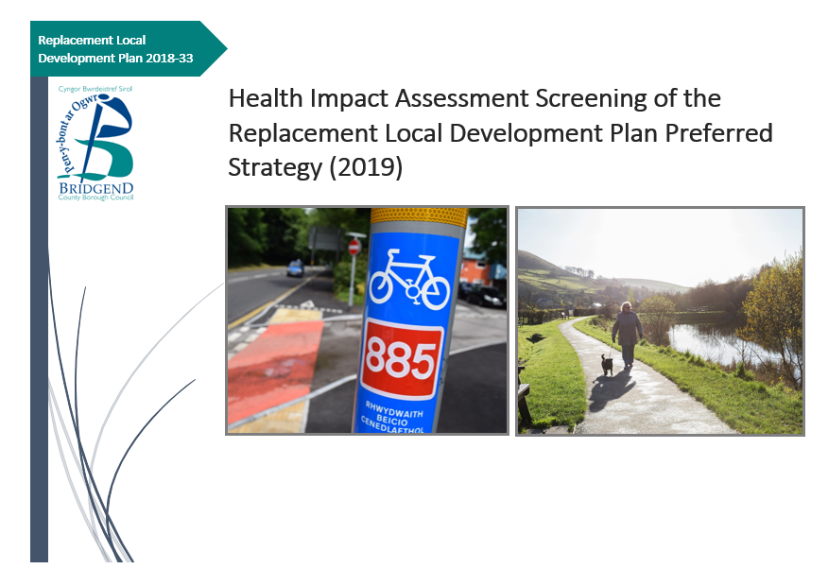
What did we achieve?
HIA
Process informed development of the Preferred Strategy & strategic policies
A HIA Screening Report was prepared for the Assets sub Board

Slide 20
What did we achieve?
HIA
  HIA Screening Report informed the development of the Preferred Strategy & strategic policies
  key health impacts are addressed
  identification of where key health impacts could be addressed in new policies within the LDP
  mapping other opportunities for health and well-being in the LDP process.

Slide 21
Next steps
HIA
To strengthen the opportunities that the LDP presents for health and well-being:
HIA for the Deposit Plan
Develop Supplementary Planning Guidance (SPG) on Health and Well-being, Hot Food Takeaways and air quality.
Ensure health sector engagement in the review of the Green Infrastructure SPG.
Community engagement - An action is included for the PSB Assets sub group to consider how local engagement and involvement in the LDP could be maximised via the PSB partners.
Further engagement and data sharing with Local Health Board and Primary Care clusters to establish land use needs for healthcare facilities on sites allocated for development.

Slide 22
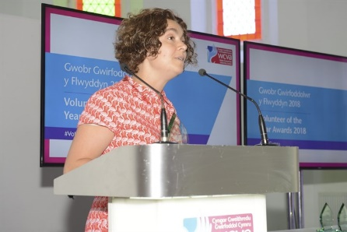
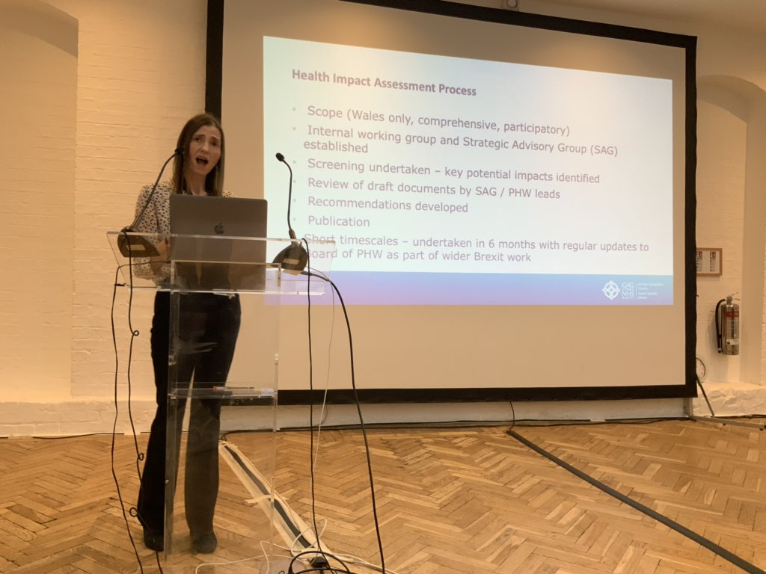


Appreciation
HIA
Continue to engage & collaborate with PHW and PSB - final draft of LDP
Relationships established – PHW / PSB

Slide 23
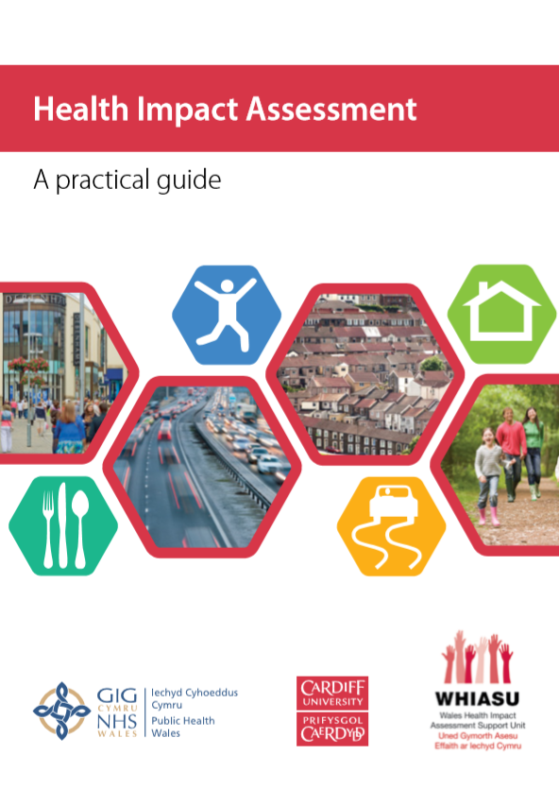
HIA
Further guidance is also available
A Practical Guide’ (Wales Health Impact Assessment Support Unit, WHIASU)

Slide 24
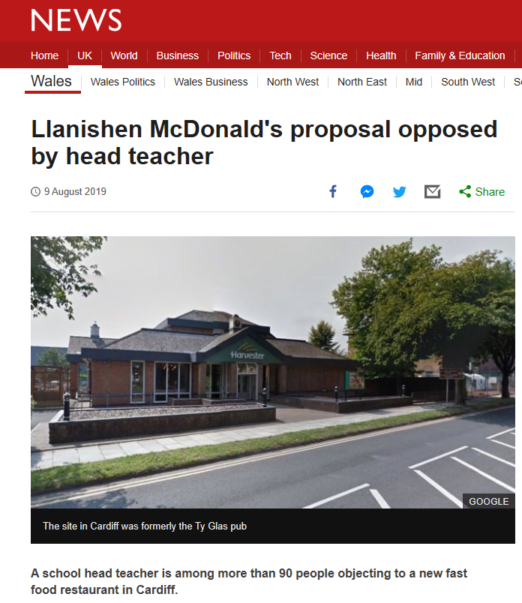
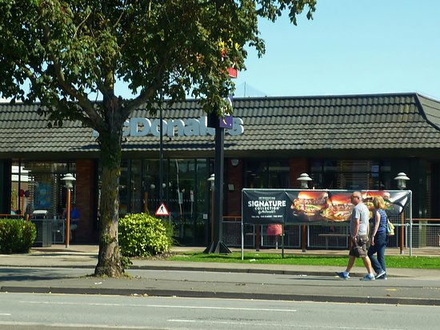
HIA
Fast Food Takeaways
300m Coed Glas Primary School
Walking distance to Comprehensive
How can Planning address this key issue?
Change required
Notes:
Not a dig at Cardiff City Council – this could happen anywhere. Planning not equipped at present to deal with this type of issue. Decision made on technical issues such as impact upon the road network, design, impact on residential amenity.

